Slide 2
Volunteer Dev Opportunity
Washington County Affordable Housing Coalition - working to help families bring their homes up to code, helping families to find adorable housing
Seekers of Success - working together to incubate non-profits who are working to help the needy in Washington County
Casa Hispana Inc - Casa Hispana's mission is to positively integrate Hispanics by networking information, capabilities and services, creating opportunities for full participation and contribution in our community.
Contact Info
Jamie Carithers
jcarithers@familypromisewc-ok.org
918-914-9125

Slide 3

Modern Web Design
Presented by Mitch Cooper

Slide 4


About Me
2010 Alumni Kansas State
Computer Engineering
Fun Fact
Hobbies

Slide 5


Modern Web Design
CSS Frameworks
Javascript Frameworks
Angular & BreezeJS
Cache Busting Your SPA

Slide 6
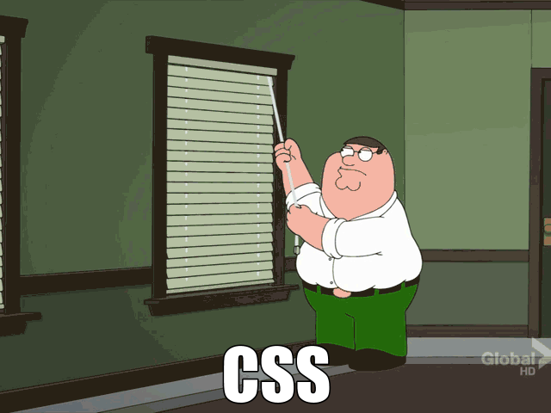
CSS Frameworks
Why use a framework?
But frameworks are heavy
“Hey! My new website looks just like everyone else’s”
What should I use?

Slide 7
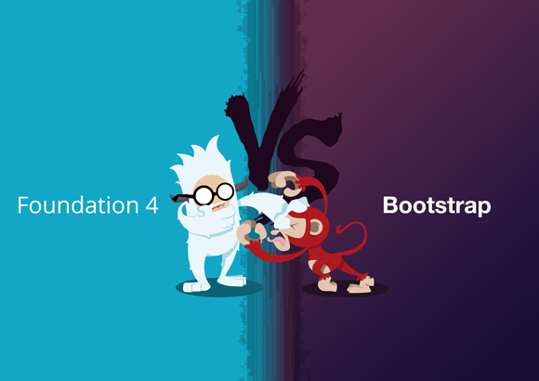
Some Good Options

Slide 8
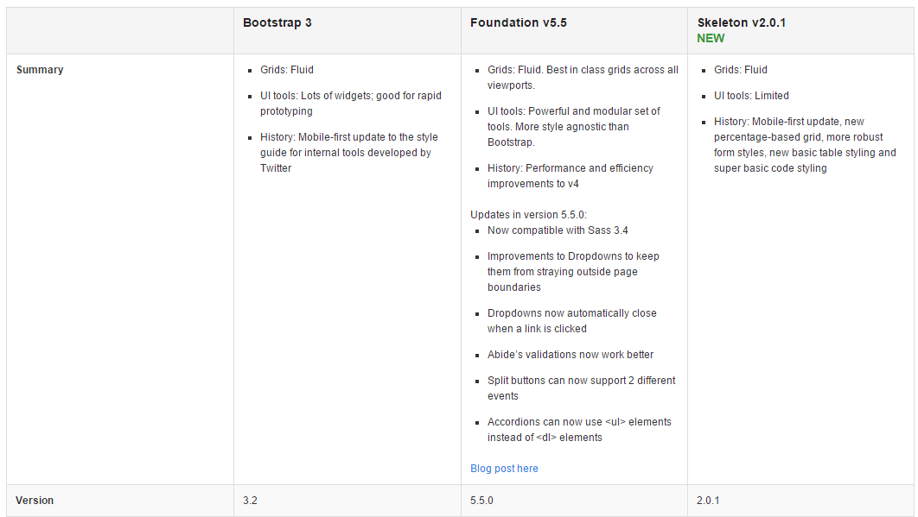
Quick Comparison
http://responsive.vermilion.com/compare.php

Slide 9
Bootstrap

Slide 10

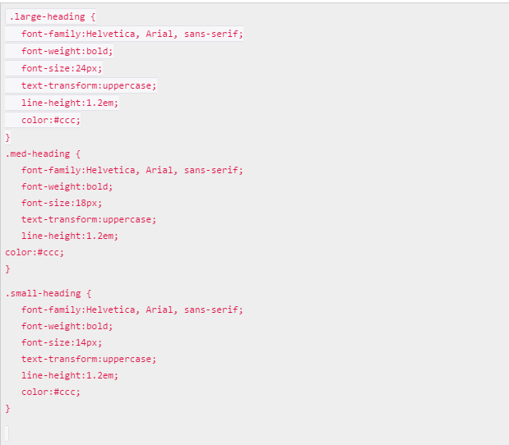
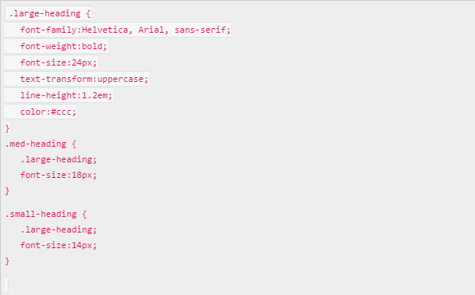
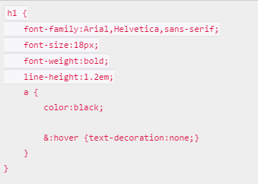
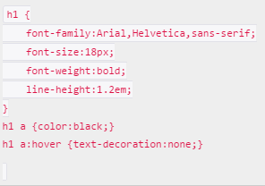
.LESS is more
LESS = The dynamic stylesheet language
Why use .LESS?
WinLess

Slide 11
Training
PluralSight
Bootstrap 3
Responsive Websites With Bootstrap 3
Webdesignerdepot.com
How to get started with Foundation 5

Slide 12


Javascript Frameworks
Why?
Javascript frameworks are bloated
You shouldn’t make users download more than what’s needed
Don’t trust others code!
Do more with less code
Save Time
Would you code your own OS?

Slide 13
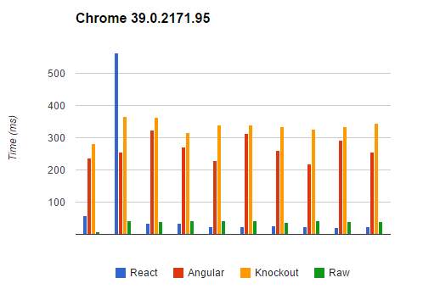
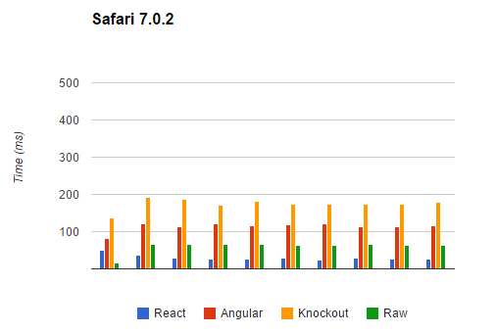


What to Use
https://www.codementor.io/reactjs/tutorial/reactjs-vs-angular-js-performance-comparison-knockout

Slide 14


Superheroic Javascript MVW Framework
Model-View-Whatever (MVC, MVVM, MVP)
DOM has markup
Data is POJO (Plain Old Javascript Objects)

Slide 15
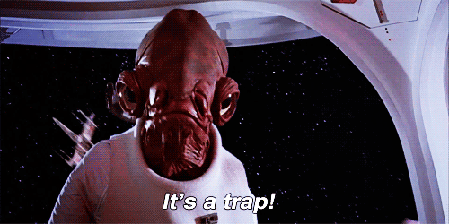


Slide 16

What Breeze can do for You
Caching and Sharing
Easy Queries
Object Graphs
Validation
Check it out!

Slide 18
Recommended Training
PluralSight
Building Apps with Angular and Breeze Parts 1 & 2 (10 hrs)
http://learn.breezejs.com/

Slide 19

Cache Busting Your SPA
Forget Me Not - Javascript Caching
Several Approaches
MVC.NET Bundling and Minification
Javascript Versioning

Slide 20
Questions ?

